Slide 1





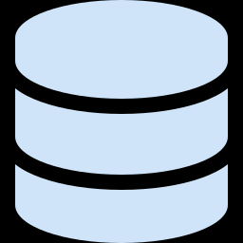

POUNCE SENTINEL
MICROSOFT BUILD AI 2026 · SECURITY IN THE AGENTIC FUTURE
Runtime security guardrails
for AI coding agents
Every AI agent calls Pounce before it adds a dependency — and gets back allow, warn, or block, with evidence and an audit trail.
BUILT ON
Microsoft Foundry
Azure Functions
Cosmos DB
GitHub Actions

Slide 2





Supply-chain risk is now runtime risk
Malware now executes at install time — inside developer machines, CI runners, and AI-agent workflows, before any scanner reacts. Over 99% of it ships through npm.
845,204
37
32
MALICIOUS PACKAGES
NPM PACKAGES
PACKAGES, 90+ VERSIONS
open-source packages catalogued by Sonatype — 16,279 of them found in Q2 2025 alone.
hijacked by IronWorm — a Rust worm (eBPF rootkit + Tor C2) that steals cloud, Vault & AI keys.
poisoned in Red Hat's npm scope; install hooks stole Vault, K8s & CI secrets.
Sonatype · Open Source Malware Index, Q2 2025
JFrog Security Research · Jun 2026
“Miasma” mini-Shai-Hulud · 2026
The install step is the breach point. AI coding agents add dependencies faster than security teams can review them — so the control has to run before the install, not after.

Slide 3



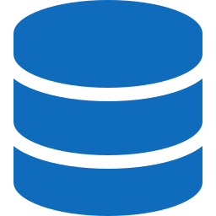



A policy checkpoint before the agent acts
Pounce sits in front of every dependency install, manifest edit, or sensitive tool action — and returns one governed verdict.
Agent request
Pounce policy engine
Allow · Warn · Block
Audit record → Cosmos DB
ALLOW
WARN
BLOCK
lodash@4.17.21
lodash@^4.17.0
event-stream@3.3.7 · risk 92
Exact, known-safe release. The agent proceeds.
Floating version — pin to an exact release first.
Known-malicious package. Stopped before install.
Every verdict carries a risk score, evidence, a policy ID, and an audit ID — so each decision is explainable and reviewable.

Slide 4





One policy, the whole Microsoft stack
Pounce is a single policy API. Every place an agent or developer can introduce risk calls the same checkpoint.
OpenAPI tool call
Microsoft Foundry
Azure Functions
allow · warn · block
agent calls Pounce before it acts
Pounce policy API + threat feeds
+ risk score, evidence & auditId
BACKED BY
Azure Cosmos DB
Application Insights
Azure Key Vault
durable allow/warn/block audit records
telemetry & observability on every decision
integration secrets & credentials
THE SAME POLICY ALSO GATES
GitHub Actions
Azure Static Web Apps
PR merge gate — the same allow / warn / block policy runs on every dependency change, protecting human and agent pull requests before code lands.
Security operations dashboard — risk queue, verdict evidence, policy tabs and live feed health, served from the same Azure-backed API.

Slide 5
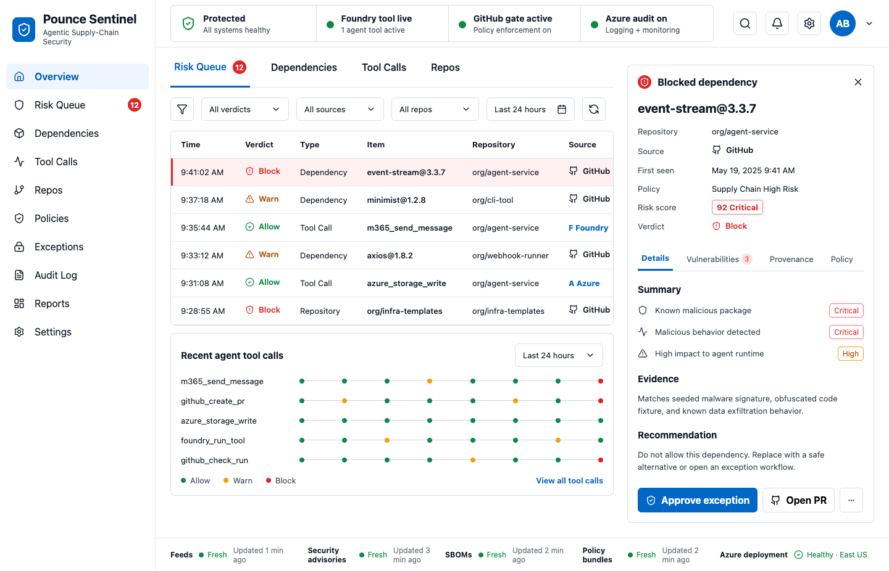



It runs live — not a mock
A Foundry agent stopped before install, the bypass caught at commit, and a live Azure-backed operations dashboard.
THE RUNTIME MOMENT
lodash@4.17.21
ALLOW
lodash@^4.17.0
WARN
event-stream@3.3.7
BLOCK
Bypass attempt — agent edits package.json directly:
scan_manifest → blockedCount: 1 → commit refused
The same checkpoint catches the dependency even when the install command is skipped.
DEPLOYED ON AZURE
Foundry agent
pounce-sentinel-policy-guard
Azure Static Web Apps dashboard · live Azure-backed API · Cosmos audit
Azure Functions
policy API
Cosmos DB
audit store
App Insights
telemetry

Slide 6

FROM TRUSTED-BY-PROMPT TO GOVERNED-BY-POLICY
A trust checkpoint for agentic software development.
Pounce turns every risky agent action into a governed security decision — with evidence, auditability, and human review.
Runtime guardrail
One policy everywhere
Evidence by default
Decisions happen before the action runs, not after the breach.
Foundry, Azure Functions and GitHub share the same checkpoint.
Risk score, evidence and an audit ID on every verdict.
Pounce Sentinel · Microsoft Build AI 2026 · Security in the Agentic Future

